Slide 1
GITHUB CLINIC 2.0

Slide 2
What will we learn?
- What is the problem?
- What is Git and GitHub?
- How does it work?
- How to Use Github?

Slide 3
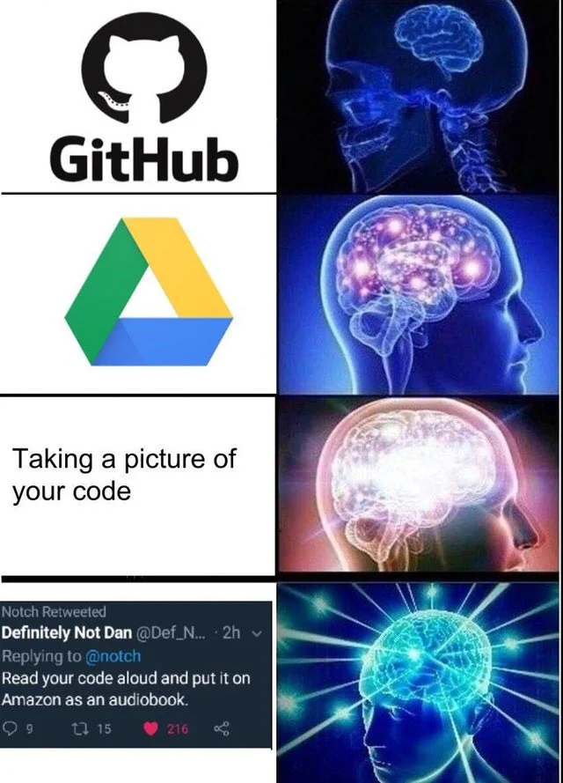
How do pass your code?
Google Drive?
Pendrive?
Screenshot?

Slide 4
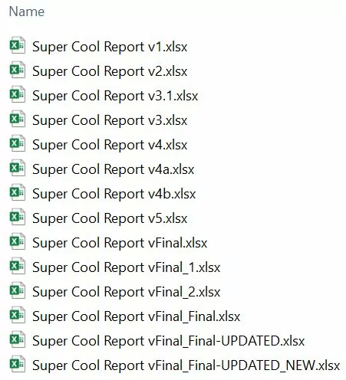
Have this ever happened?

Slide 5
How can we solve this?

Slide 6



Introducing Version Controlling System (VCS)

Slide 7
A version control system is a kind of software that helps the developer team to efficiently communicate and manage(track) all the changes that have been made to the source code.

Slide 8
What is Git?
“Git is a free and open-source distributed version control system designed to handle everything from small to very large projects with speed and efficiency.” – git-scm.com

Slide 9
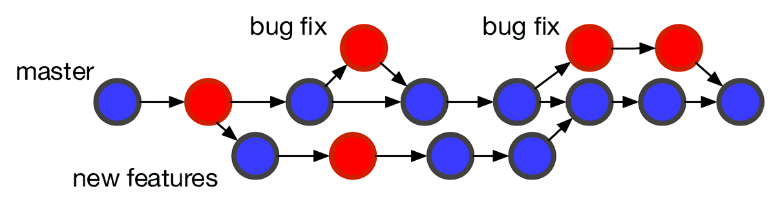
How does Git Work?

Slide 10
Why use Git?
You can revert your changes easily
You can work in parallel with your teammates

Slide 11

Introducing Github

Slide 12
What is Github
“GitHub, Inc. is a platform and cloud-based service for software development and version control using Git, allowing developers to store and manage their code.” - Wikipedia

Slide 13

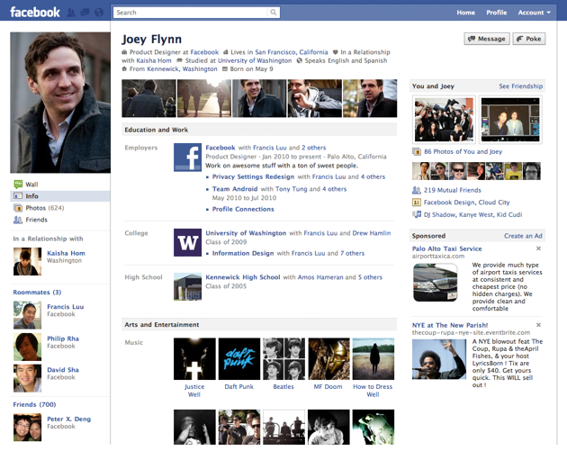
Git vs Github
Is like
Personal Diary vs Facebook

Slide 14
Git (Personal Diary) | Github (Facebook)
Is stored locally | Is stored online and cloud based
Is purely a tool to record your progress and history | Is a website where you can record and share your progress and history to others
Can only be used to record information | Contains other features such as Comments, profile page and more!

Slide 15
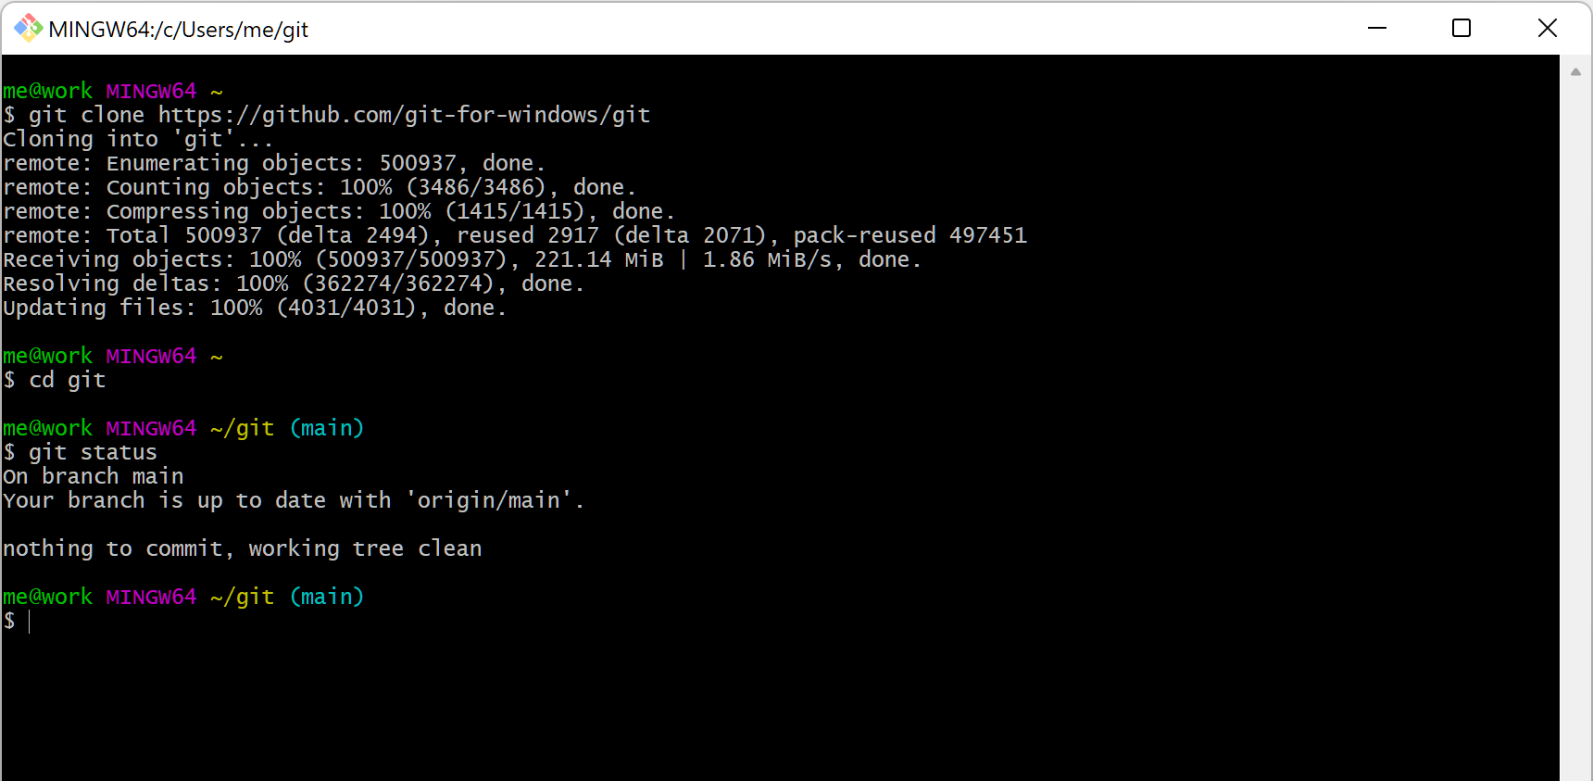
This how Git looks like..
Fortunately, there is alternative

Slide 16

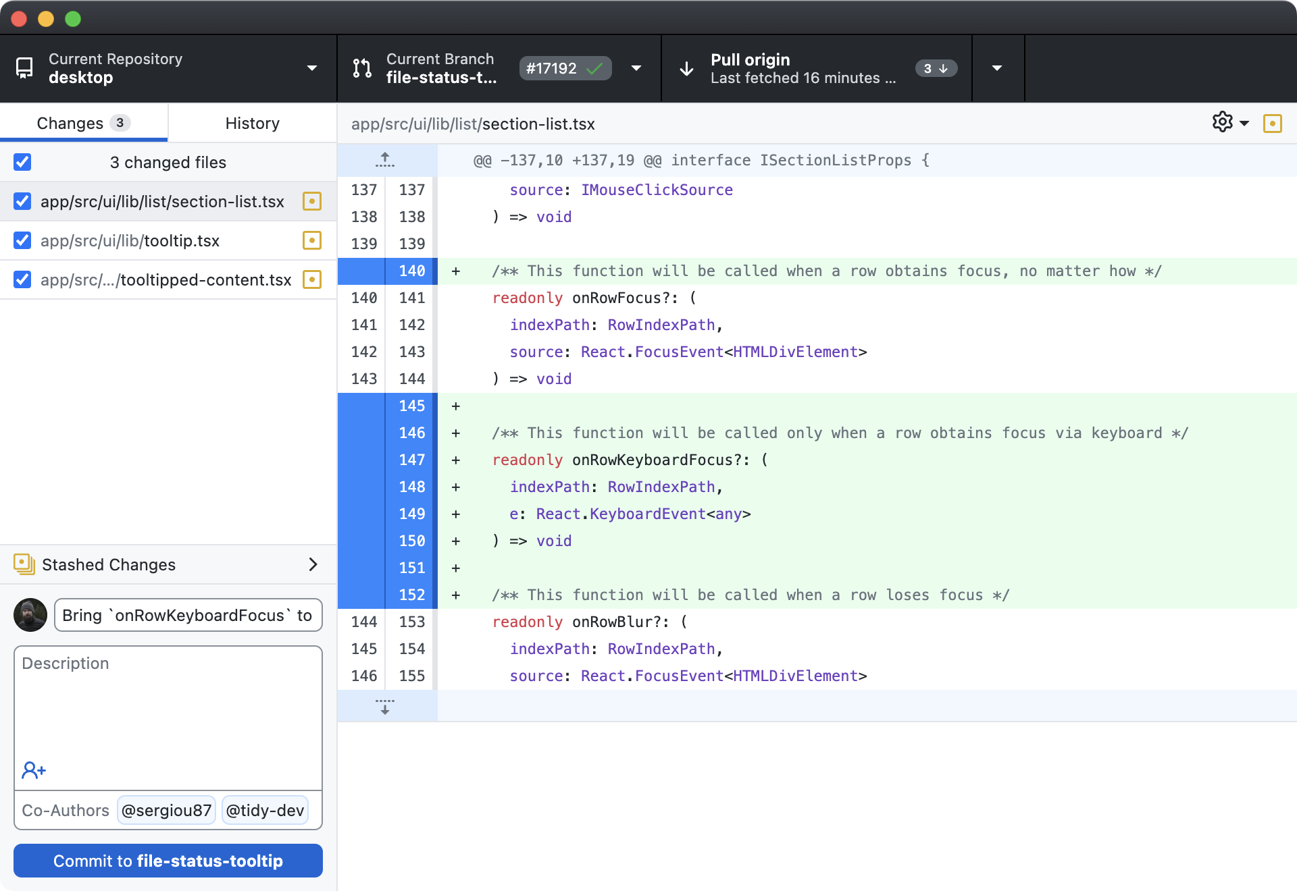
Introducing Github Desktop

Slide 17
In Conclusion
The Version Control System
A place to host your code
GUI Software for git

Slide 18

Git terms

Slide 19
Git terms
Local Repository
- A place where you place your code
- Is on your computer

Slide 20
Git terms
Remote Repository
- A main repository that act as source of truth
- Not on your computer
- Also referred as centralized server or “origin”

Slide 21
Git terms
Commit
- A snapshot of the code at the time
- Commit mean saving your code progress on your local repository

Slide 22
Git terms
Push
- Uploading your progress to remote repository.

Slide 23
Git terms
Fetch
- Downloading contents from remote repository.
- Is used to update your local repository with latest changes.

Slide 24
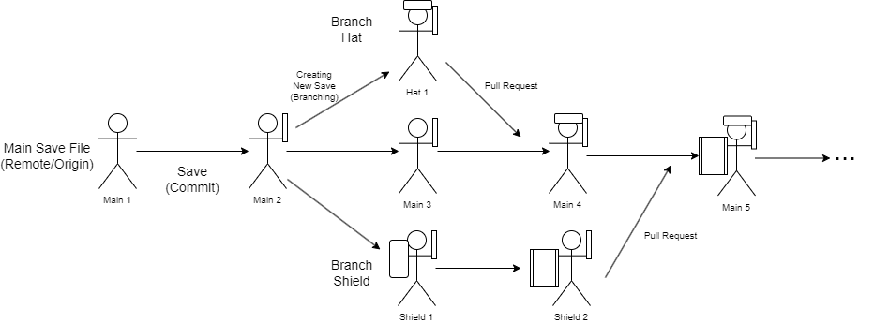
Git terms
Branch
- Is a new/separate version of the main/master repository

Slide 25
Git terms
Pull Request
- Requesting the owner to merge branch and main

Slide 26
Git terms
Clone
- Copy the remote repository from GitHub.com to your local machine
Remote Repository
Local Repository

Slide 27
Git terms
Fork
- Copy other people remote repository on GitHub
Member A’s Remote Repository
Team Leader’s Remote Repository
Member B’s Remote Repository

Slide 28
Let’s Get Started!

Slide 29
First of all..
1. Create a Github Account (github.com)
2. Download Github Desktop (desktop.github.com)
3. Login to Github Desktop

Slide 30
First Task
Create a New Repository

Slide 31
First Task
1. Create a new repository on Github
2. Clone the repository to your PC

Slide 32
Second Task
Add new files and commit

Slide 33
Second Task
1. Open the local repository on your PC.
2. Create a new text file called helloWorld.txt, type your name inside the text file
3. Commit your new changes on Github Desktop
4. Push the changes.

Slide 34
Third Task
Fork another repository
steal copy other code

Slide 35
Third Task
1. Create a fork from (github.com/zhoreeff/GitHub-Clinic-2.0)
You also can use the search function to find the repository
2. Clone the fork repository to your PC

Slide 36
Fourth Task
Creating a New Branch
From the forked repository

Slide 37
Fourth Task
1. Create a branch from the repository.
2. Add your name into the html file inside the local repository.
3. Commit the changes.
4. Push the changes.

Slide 38
Fifth Task
Merging a Branch with Main/Master

Slide 39
Fifth Task
1. Open a pull request on GitHub
2. If you are a leader, accept pull request and merge the branch with main

Slide 40
Sixth Task
Update Local Repository

Slide 41
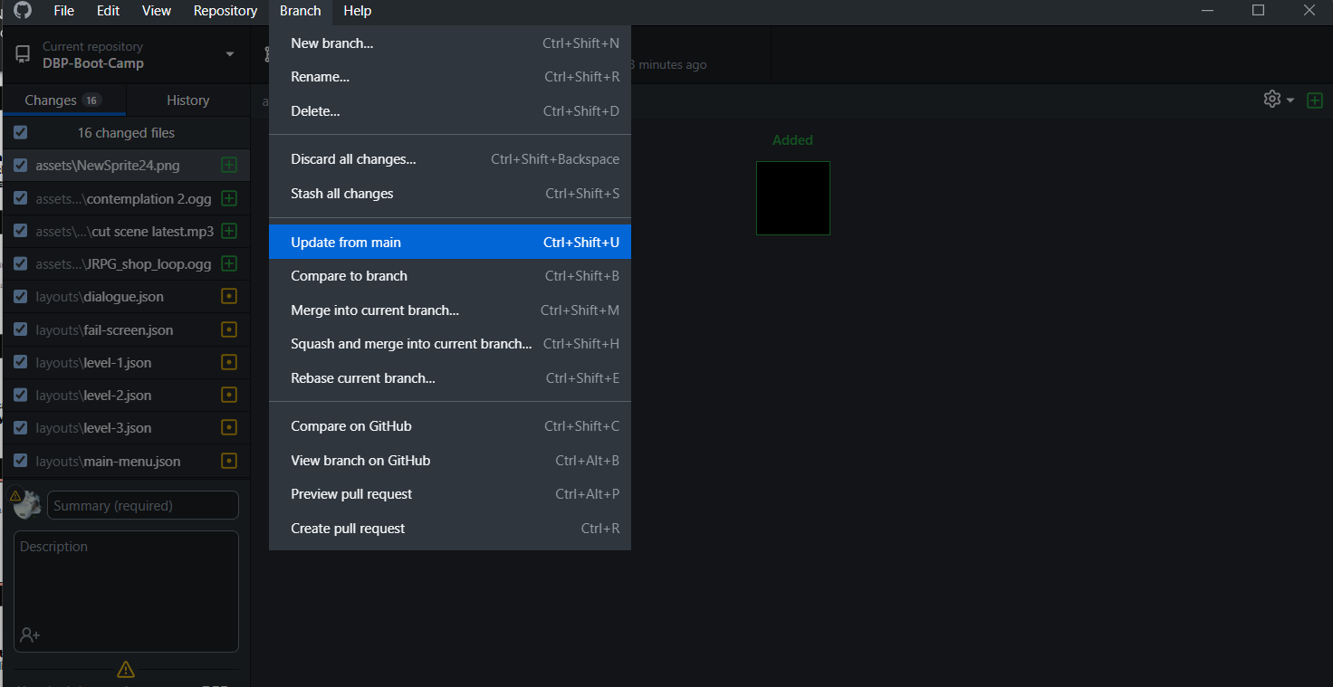
Sixth Task
1. Update your local repository to match
the main branch.

Slide 42
Bonus Task
Dealing With
Merge Conflict

Slide 43
So, in general..
Group Leader:
- Create a repository and lay out the boilerplate code
- Check and approve/disapprove pull request
All team members:
- Create a branch (if necessary)
- Make sure the branch is always up to date
- Make sure commit messages are useful and make sense
- Don’t commit generated files (use .gitIgnore to exclude files)
- Don’t commit secrets such as password etc

Slide 44
That is all..

Slide 45
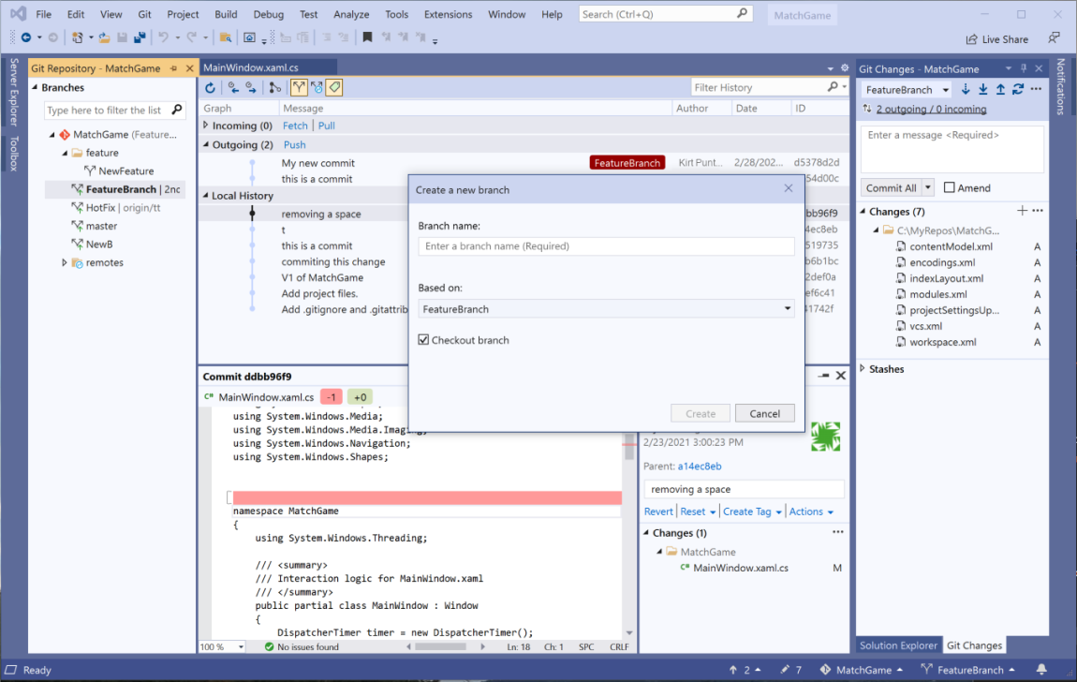
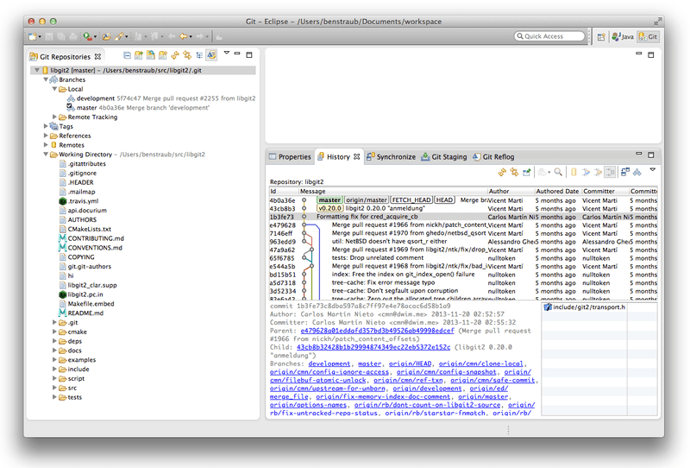
But wait There’s more!
Some IDE also have integrated Github features
Visual Studio
Eclipse

Slide 46
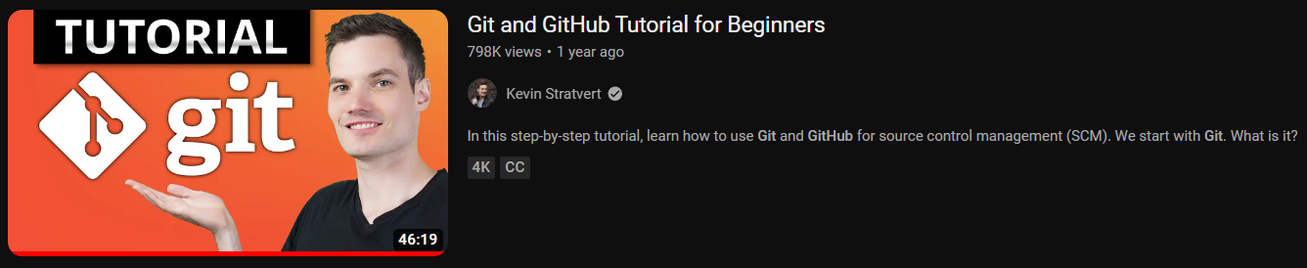
But I don’t want to use Github Desktop or IDE
- You can always learn the CLI method, which is still the most popular methods among the programmer
- Most used terminal is called GitBash
This video by Kevin Stratvert is a good starting point

Slide 47
But wait There’s more!
Github also contains other features such as:
- Documentation (wiki, README, etc)
- Discussion (Issues, Forum, etc)
- Statistics (Contributors, etc)
- Github Co-pilot (Like ChatGPT but for coding)
- Profile
And more!

Slide 48
That is all..
(for real this time)
Thank You for attending the class

Slide 49
Q&A

